Slide 1
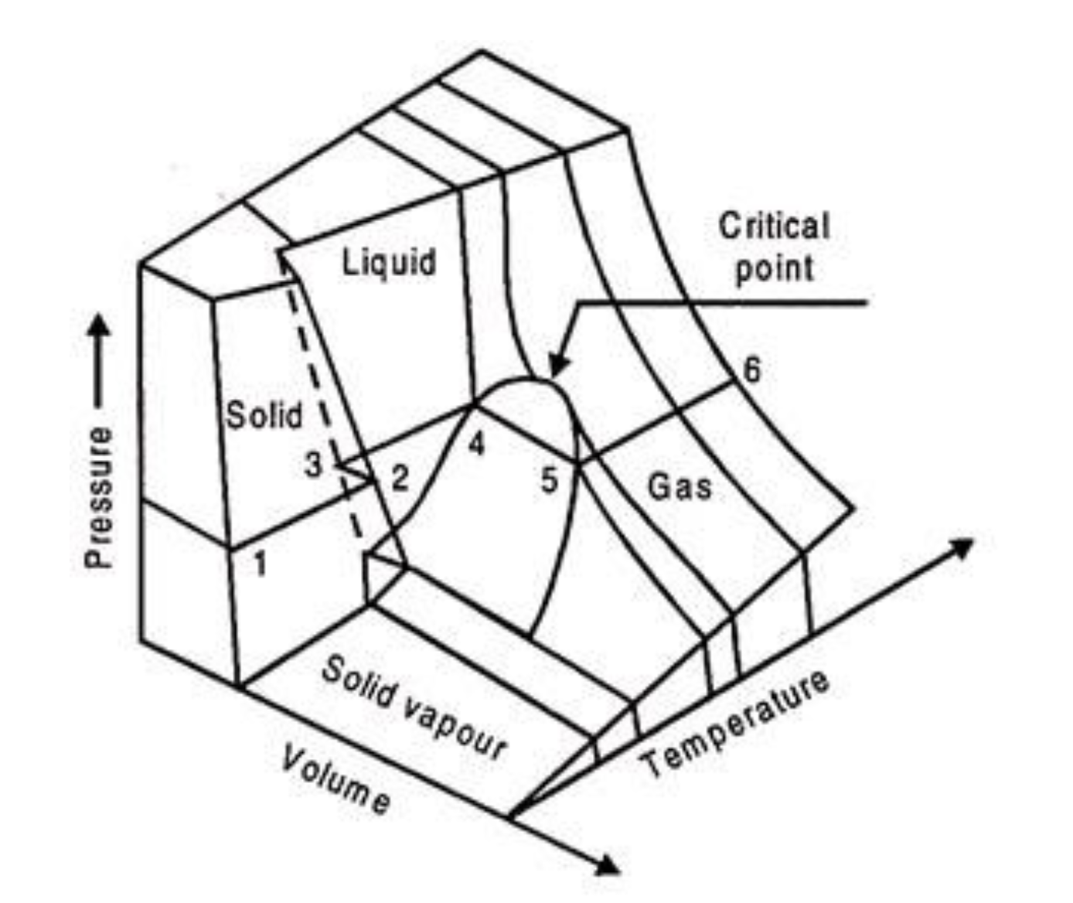
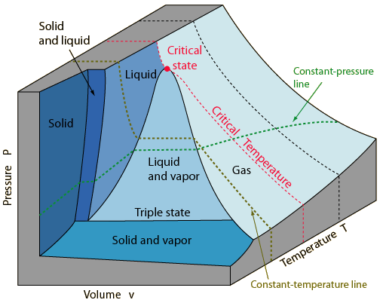
What all gases/liquids/solids do
The Principle of Corresponding States says all substances do this, just at different temperatures and volumes.
Here, we’ll focus on the critical point.
https://www.engineeringenotes.com/thermal-engineering/real-gases/real-gases-properties-van-der-waals-equation-and-equation-of-state-thermal-engineering/49112

Slide 2


How you can tell if a gas is supercritical or subcritical
Isothermal compression below and above the critical temperature
$$T<T_{c}$$
$$T>T_{c}$$
gas
gas
Super-critical Gas/
Liquid
gas
liquid
liquid
liquid

Slide 3
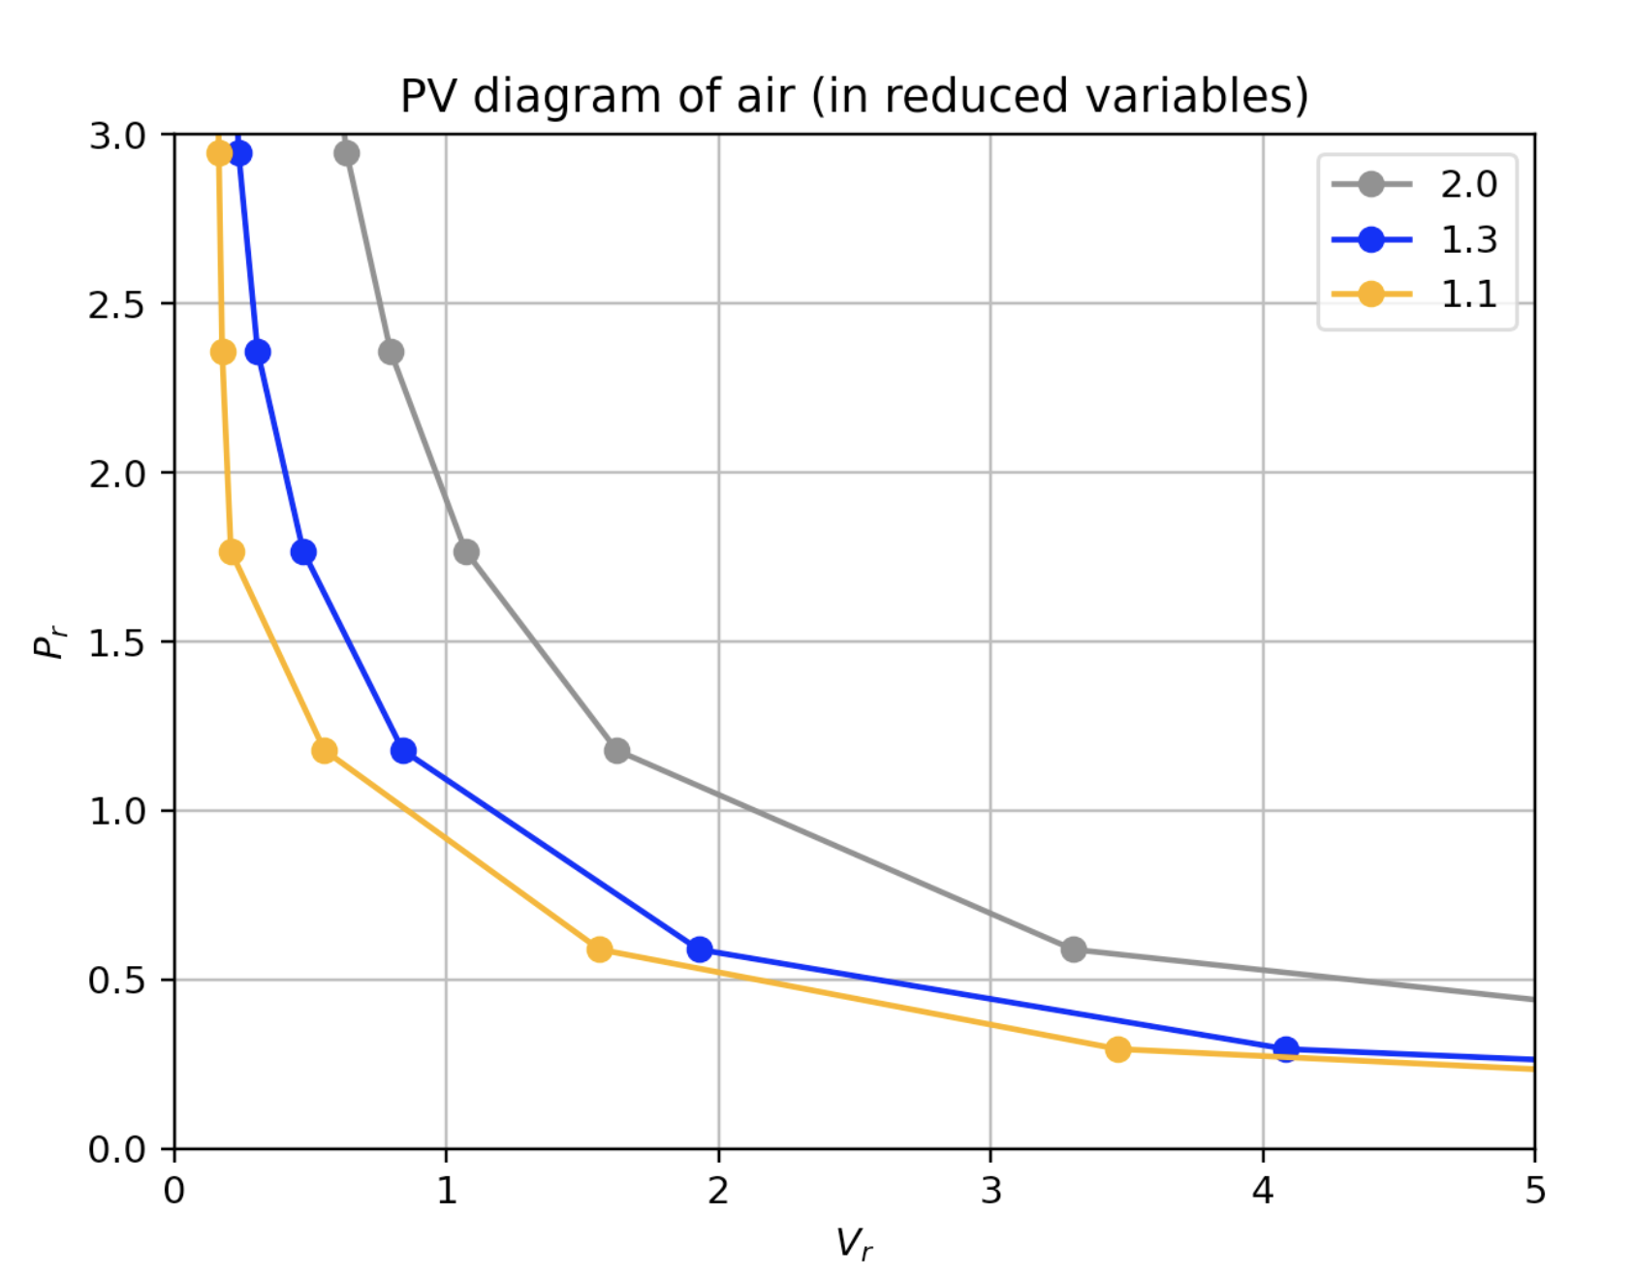
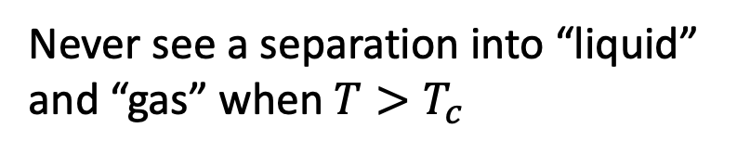
How you can tell if a gas is supercritical or subcritical
$$T>T_{c}$$
Never see a separation into “liquid” and “gas” when $T>T_{c}$
gas
Super-critical Gas/
Liquid
liquid

Slide 4

How you can tell if a gas is supercritical or subcritical
$$T>T_{c}$$
Never see a separation into “liquid” and “gas” when $T>T_{c}$
gas
Super-critical Gas/
Liquid
liquid

Slide 5
Approaching 𝑻_{𝒄rit} from above
$$T>T_{c}$$
But there’s a hint of something afoot: along colder isotherms, P(V) gets flatter and flatter.
gas
Super-critical Gas/
Liquid
liquid

Slide 6
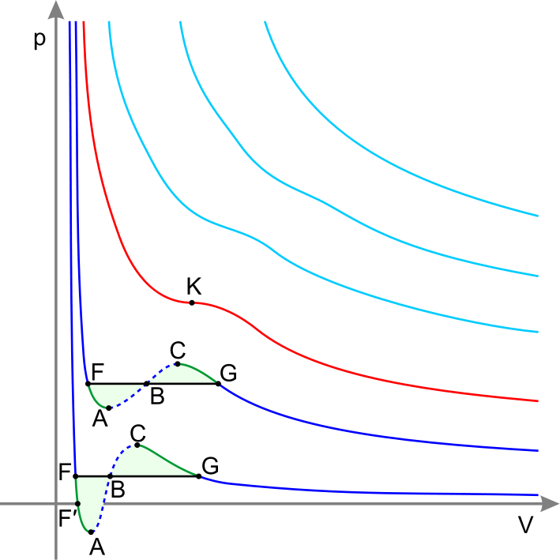


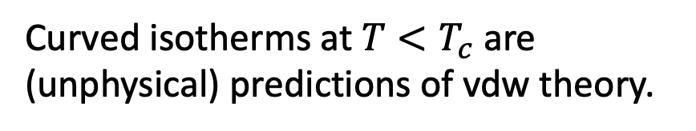
van der Waals formula actually does a good job when 𝑻>𝑻_{𝒄rit}
Isothermal compression in a PV diagram
$$T>T_{c}$$
$$T=T_{c}$$
T_{crit}
Curved isotherms at $T<T_{c}$ are (unphysical) predictions of vdw theory.

Slide 7
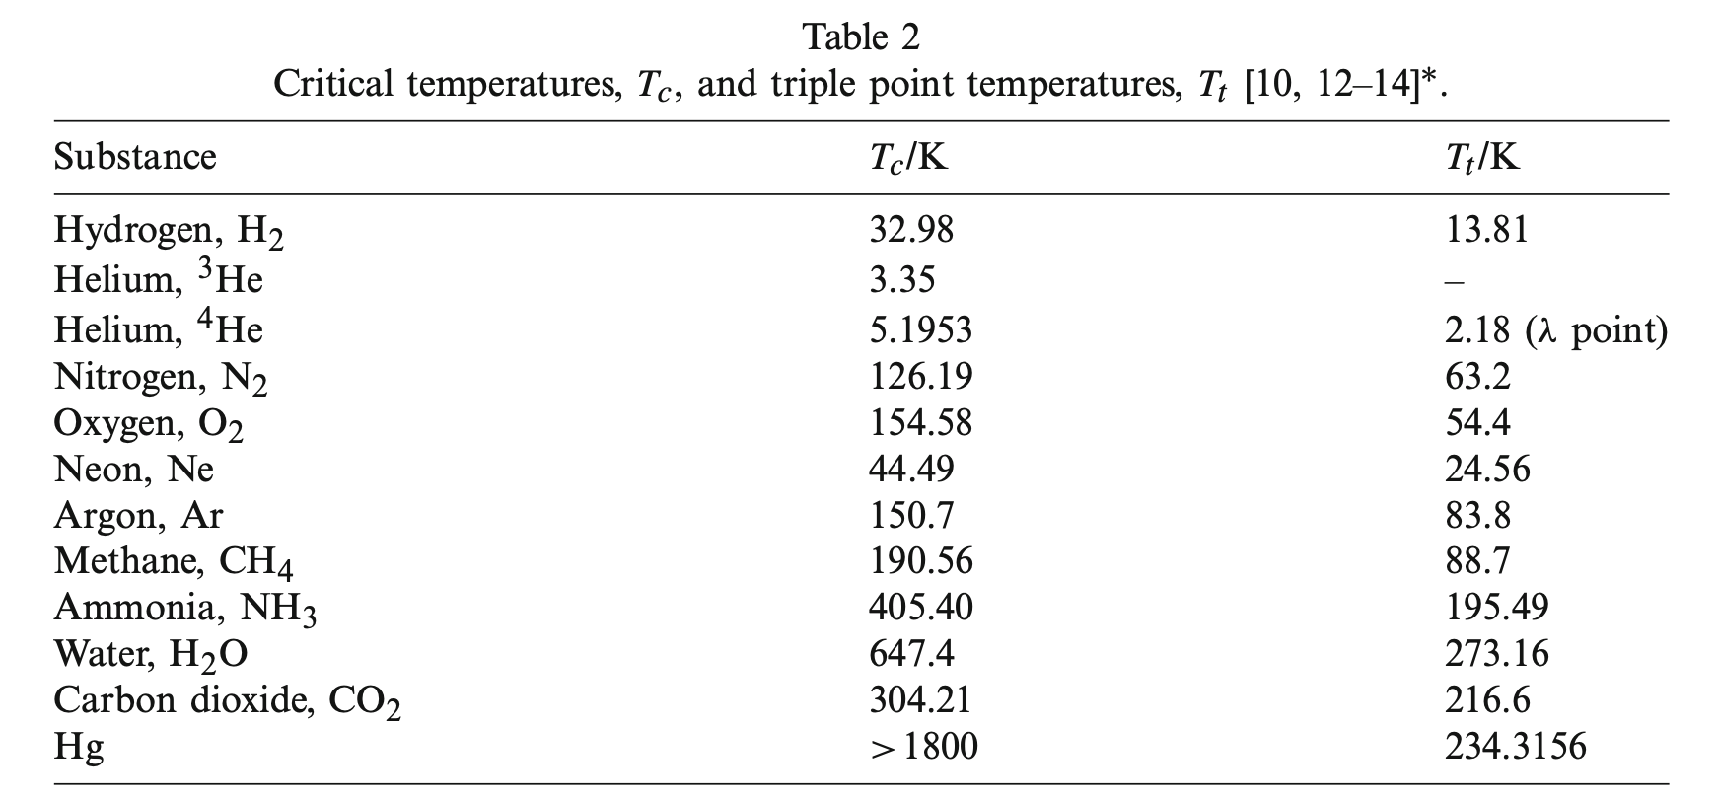

Every gas has its own critical temperature
$$T_{3}/K$$
From Berberberan-Santos et al, 2008

Slide 8

Every gas has its own critical temperature
$$T_{3}/K$$
From Berberberan-Santos et al, 2008
H₂ molecules are not very sticky, so it’s hard to liquify H₂ gas => H₂ has a really low critical temperature.

Slide 9
Every gas has its own critical temperature
$$T_{3}/K$$
From Berberberan-Santos et al, 2008
H₂O and NH₃ molecules are very sticky (they have hydrogen bonding!) so it’s easy to liquify them => H₂O and NH₃ have really high critical temperatures.

Slide 10
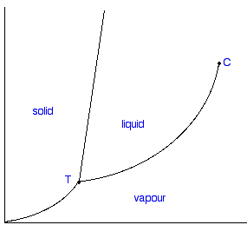



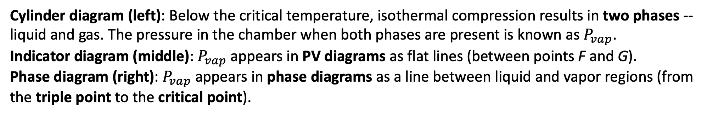


When the temperature is sub-critical ($T<T_{c}$), two phases (gas and liquid) are in equilibrium
Cylinder diagram (left): Below the critical temperature, isothermal compression results in two phases -- liquid and gas. The pressure in the chamber when both phases are present is known as $P_{vap}$.
Indicator diagram (middle): $P_{vap}$ appears in PV diagrams as flat lines (between points F and G).
Phase diagram (right): $P_{vap}$ appears in phase diagrams as a line between liquid and vapor regions (from the triple point to the critical point).
Cylinder diagram
Indicator diagram
Phase diagram
$$P$$
$$P$$
critical point
solid
liquid
gas
gas
triple point
liquid
gas
$$T<T_{crit}$$
$$V$$
$$T$$

Slide 11
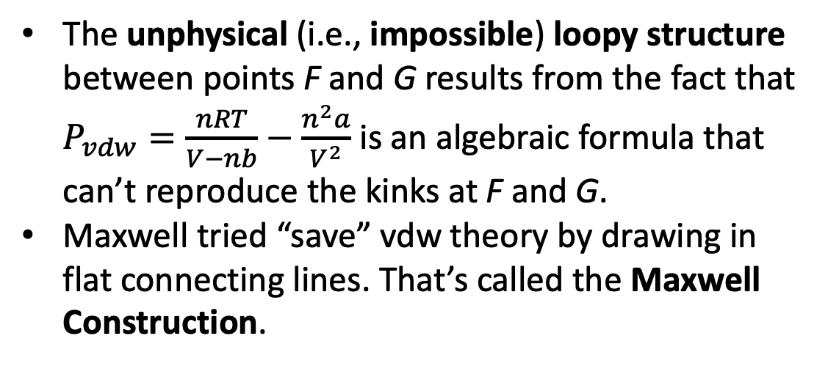
How Maxwell tried to save vdw theory in the 2-phase region
The unphysical (i.e., impossible) loopy structure between points F and G results from the fact that $P_{vdw}=\frac{nRT}{V−nb}−\frac{n^{2}a}{V^{2}}$ is an algebraic formula that can’t reproduce the kinks at F and G.
Maxwell tried “save” vdw theory by drawing in flat connecting lines. That’s called the Maxwell Construction.

Slide 12
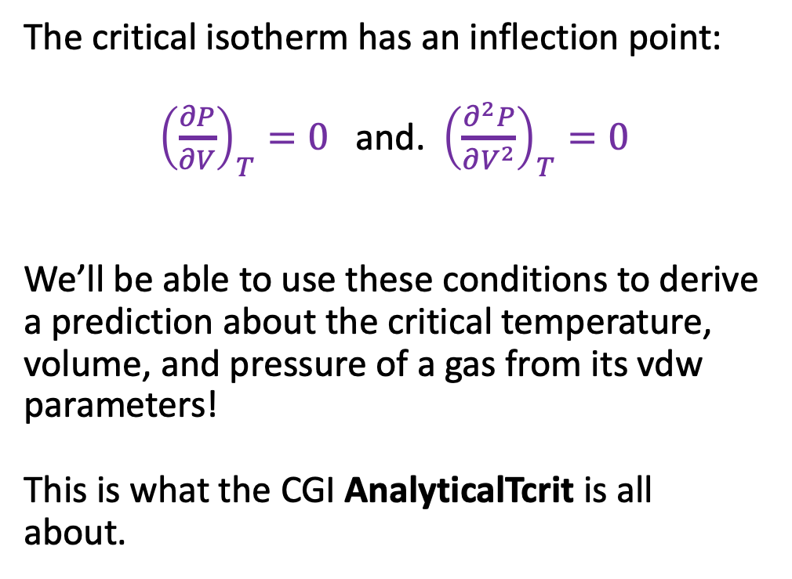
$V_{C}$, $T_{C}$, and $P_{C}$, and their relationship to vdw’s parameters
The critical isotherm has an inflection point:
${\left(\frac{∂P}{∂V}\right)}_{T}=0$ and. ${\left(\frac{∂^{2}P}{∂V^{2}}\right)}_{T}=0$
We’ll be able to use these conditions to derive a prediction about the critical temperature, volume, and pressure of a gas from its vdw parameters!
This is what the CGI AnalyticalTcrit is all about.

Slide 13
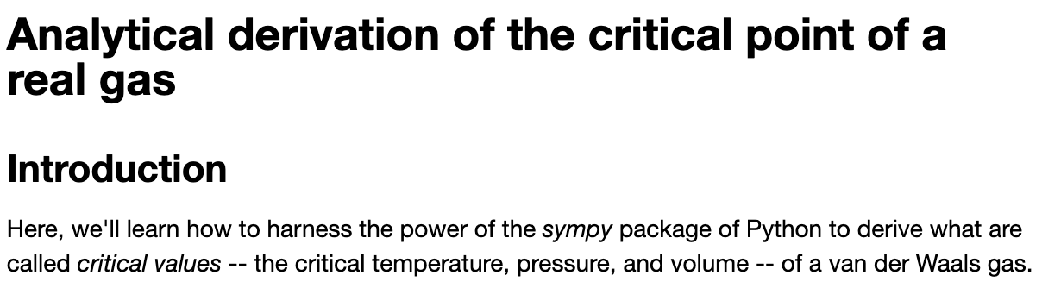
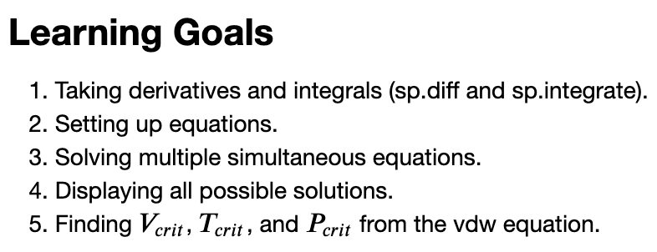
Let’s get started with AnalyticalTcrit …

